Slide 1

ML Project: A web app for Predicting diabetes disease made by:-Naveen Dwivedi email-id:dwivedinaveen251@gmail.com

Slide 2
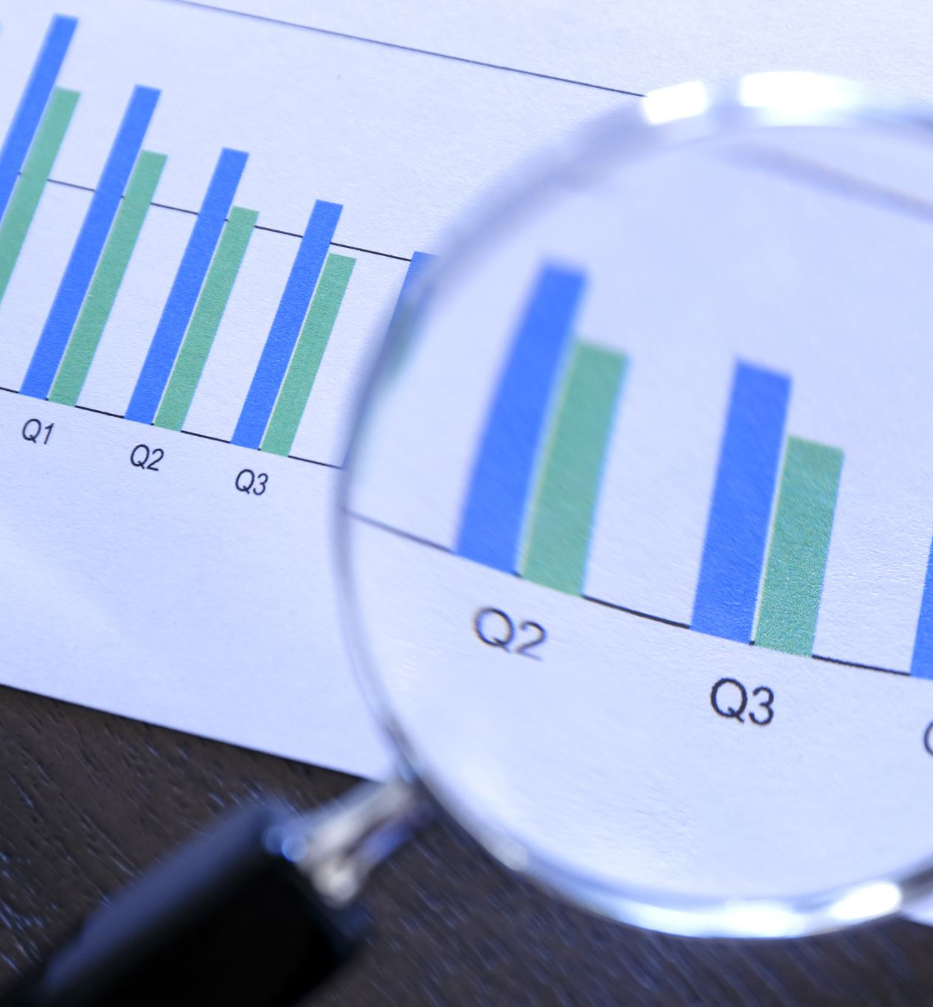
Project Description
In Diabetes Detection Prediction, We are Predicting the risk of having an diabetes on the basis of input features/data pregnancies , glucose , blood pressure, insulin level etc. Using Machine learning algorithm.

Slide 3
Diabetes Detection Modelling
Prepare and collect
Step1:Prepare and collect data
Choose
Step2: Choose an algorithms
Train
Step3:train algo. using trainnig data
Evaluate
Step4:Evaluate Model performance

Slide 4
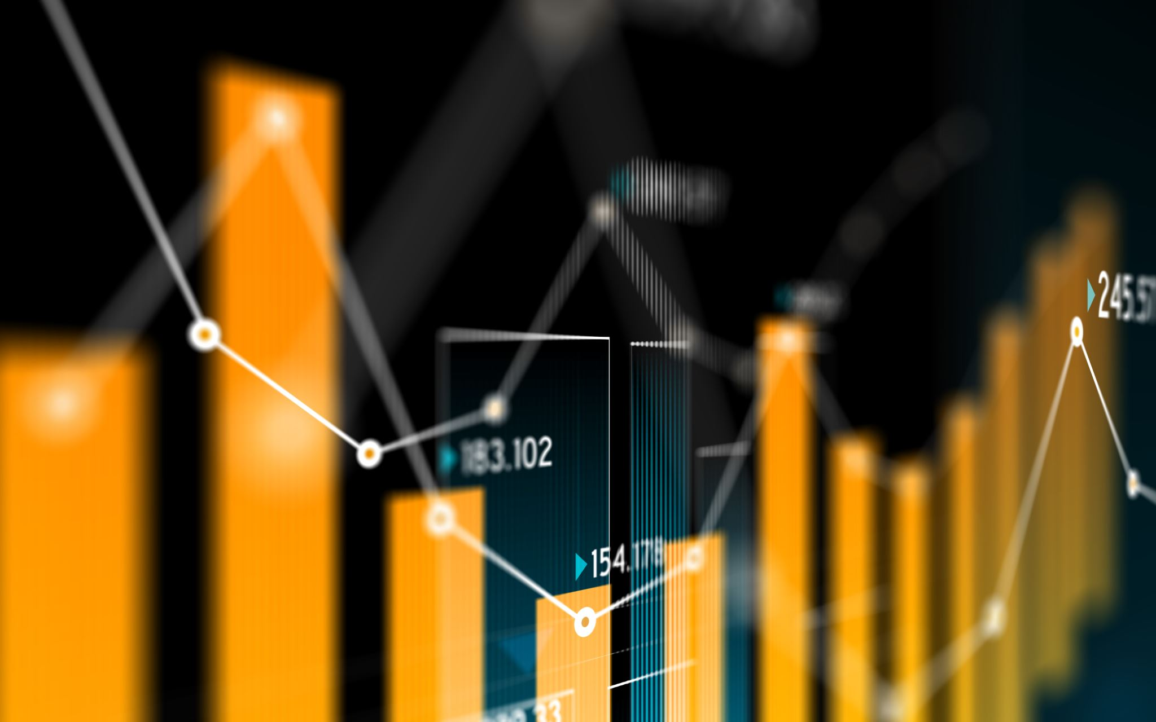
1. Collect and Prepare data
Importing neccessary libraries for mathematical analysis on daiabetes dataset like numpy, pandas , matplotlib etc.
Read and perform operation on diabetes .csv file (excell sheet dataset file)
Checking categorical or object data type feature in our data

Slide 5
1. collect and prepare data (cont..)
Checking that is there any null values in our all features like housing_median_age ,total_rooms , total_bedrooms,population, households, median_income, house_price_value, proximity (if available)
Fill all 207 null values in total_bedrooms using its mean (due to large gap)
Visualize data using histogram and finding correlation among all columns and represent it in a matrix using heatmap
We also find outliers for checking overfitting problem

Slide 6
1 . Collect and prepare data ...
Split the input features in X in target column (house_price_value in y

Slide 7
2. Choose ML algorithm
First we import important library from sklerean for spliting the data for training and testing
We import train_test_split from sklearn.model_selection
Use test_size=0.2 implies that
Our model uses test data :-20% (for prediction) , train data:- 80% ( to train our model)

Slide 8

3 Train model using training data

Slide 9
3. Train model using training data
We have multiple input features and single target value for classification of diabetes risk
We will predict on outcome as our target feature
We use random forest classifier from sklearn module , and made model as an object

Slide 10
3. Train model using training data
from sklearn.linear_model we import RandomForestClassifier class to train our model
We fit our model using train data eg:-model.fit(x_train, y_train)
It will manipulate all banckend calculation like finding all coefficients m1 ,m2,m3....etc and intercept and fit our linear model

Slide 11
4. Evaluate on Model test data
We will predict and evaluate our model performance
We will use our test data and predict method for predicting our target value ie. Outcome(yes/no)
Use model.predict(x_test) to to minimize the residual sum of squares between the observed targets in the dataset, and the targets predicted by the linear approximation.

Slide 12
Model Performance accuracy
For finding our model accuracy , we import r2_score from sklearn.metrics module . It is a regression score function.
Best possible score is 1.0 and it can be negative (because the model can be arbitrarily worse).
We have to pass y_pred and y_test in r2_score function as a arguments

Slide 13
Saving Model for Web application
We Save our Machine Learning Model using Pickle module in mlmodule.py file
We use this model further in flask for prediction and displaying the result on web browser

Slide 14
Front end- HTML and CSS
Creating a simple form for taking data from user
to predict the risk of having diabetes or not after clicking on predict button.
home.html-for taking data from end user
result.html- to show their result
CSS- style.css to provide functinality to html page

Slide 15
Flask as an back end server
Python support flask framework as a server . It act like server .
We use flask module to interact with data which is filled by user to check their medical report on diabetes detection whether the person having an risk of diabetes or not?
We use app.py file for deploying the ml model on web.

Slide 16

Thank you

